Slide 1
Interactive Timeline
By: Sasha Sairajeev and Parks Mason
98836608.nhd.weebly.com

Slide 2
Click an Event for more information…
(Insert event name here)

Slide 3
Dwight D Eisenhower’s Life
Dwight David Eisenhower is born
Eisenhower entered the U.S. Military Academy at West Point, NY
Supreme Allied Commander of NATO
Dwight David Eisenhower passes away
Marriage to Mamie Geneva Doud
Eisenhower moves to the Philippines
He becomes Army Chief of Staff
1890 1891 1892 hhh 1911 1912 1913 1914 1915 1916 1917 hhh 1935 1939 1941 1944 1945 hhh 1950 1951 1952 1956 1957 1969
World War II breaks out
Eisenhower launches the Space Race
Eisenhower and his family moves to Abilene, Kansas
Service in the First World War
Cold War Tensions Begins
Eisenhower's first son is born
Eisenhower is Re-elected
1890 1891 1892 hhh 1911 1912 1913 1914 1915 1916 1917 hhh 1935 1939 1941 1944 1945 hhh 1950 1951 1952 1956 1957 1969
Eisenhower Graduates from West Point
Commander and Instructor at Command and General Staff College
D-Day Speech
delivered
Eisenhower wins the presidential election of 1952
Eisenhower establishes the, "Eisenhower Doctrine"

Slide 4
Dwight David Eisenhower is Born
Oct 14, 1890
Dwight David Eisenhower was born on October 14, 1890 to David J. and Ida Eisenhower, the third of seven sons to his parents.
Back to Home

Slide 5
Eisenhower and his family moves to Abilene, Kansas
Jul 1, 1892
Dwight David Eisenhower wasn’t born in Abilene, Kansas, nor did he die there. But the years he spent in the central Kansas town were among the most important of his life. For it was in Abilene that the boy who would grow up to become General of the Army and the thirty-fourth President of the United States developed the skills and first displayed the character that would see him and the nation through some of the most perilous times the world has ever known. ~Eisenhower Archives
Back to Home

Slide 6
Eisenhower entered the U.S. Military Academy at West Point, New York
Jun 1, 1911
Eisenhower applied to West Point and Annapolis military academies in 1910. He requested and received an appointment from Kansas Senator Joseph L. Bristow, and was admitted to West Point in 1911.
Back to Home

Slide 7
Eisenhower Graduates from West Point
Mar 1, 1915
Eisenhower graduated from West Point in 1915 and received his commission as a second lieutenant. ~Kansas National State Library
Back to Home

Slide 8
Marriage to Mamie Geneva Doud
June 1st, 1916
Link: http://98836608.nhd.weebly.com/early-life.html
Back to Home

Slide 9
Service in the First World War
Dec 1, 1916
“Lieutenant Eisenhower is denied his request for an overseas assignment and instead serves at numerous American camps. He rises through the ranks due to his exceptional organizational skills and specializes in training tank crews. To his chagrin he never sees combat, but is awarded a Distinguished Service Medal.”(SS, 2005)
Back to Home

Slide 10
Commander and Instructor at Command and General Staff College
Apr 6, 1917
Eisenhower attends the Command and General Staff College at Fort Leavenworth, Kansas, where he graduates as Valedictorian.
Back to Home

Slide 11
Eisenhower's first son is born
Sep 24, 1917
Doud Dwight 'Icky' Eisenhower is born on September 24, 1917, but tragically dies of scarlet fever as a toddler in 1921. A second son, John Sheldon Doud Eisenhower, is born the following year on August 3, 1922 (SS, 2005)
Back to Home

Slide 12
Eisenhower moves to the Philippines
Jul 1, 1935
Eisenhower is sent to the Philippines with MacArthur to prepare the Filipino Army for independence by forming their National Army.
Link: http://98836608.nhd.weebly.com/early-military-career.html
Back to Home

Slide 13
Eisenhower returns from the Philippines to America
"In 1939 Eisenhower moves his family back to America where he holds a variety of posts. As World War II breaks out, Eisenhower is noted for his strategic organizational skills and is tasked with creating major war plans after the attack on Pearl Harbor in 1941.“ -NPS
Back to Home

Slide 14
World War II breaks out
Sep 5, 1941
World War was one of the most significant period of the 20th century. Adolf Hitler was elected as chancellor of Germany in 1933. The main combatants were the Axis nations (Nazi Germany, Italy, Japan and their other allies) and the Allied nations, led by Britain, the USSR and the United States of America.
Back to Home

Slide 15
Pearl Harbor is Attacked by the Japanese
Dec 7, 1941
Hundreds of Japanese fighter planes ambushed and attacked the Navel Base owned by the U.S at Pearl Harbor near Honolulu, Hawaii.
Back to Home

Slide 16
D-Day Speech Delivered
Jun 9, 1944
On D-Day, General Dwight D. Eisenhower, then Supreme Commander of Allied Expeditionary Forces in World War II gives the thumbs up for an invasion in Europe called Operation Overlord.
Back to Home

Slide 17
He becomes Army Chief of Staff
U.S Army 1945-1948
Back to Home

Slide 18
Cold War Tensions Begin
During Eisenhower's first term, he attempts to stress the severity of spreading communism and using our atomic arms appropriately.
Back to Home

Slide 19
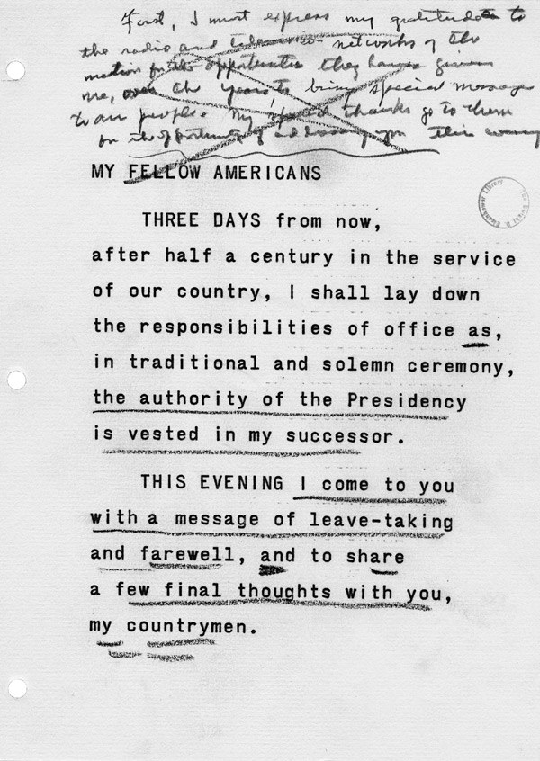
Eisenhower establishes the, "Eisenhower Doctrine"
.
Back to Home

Slide 20
Eisenhower is Re-elected
1956
He promises in his second term great economic prosperity and the establishment of Civil Right Acts.
Back to Home

Slide 21
Eisenhower launches the Space Race
As Russia launches Sputnik I, President Eisenhower rushes into the, "Space Race," by establishing the National Aeronautics and Space Administration (NASA).
Back to Home

Slide 22
Dwight David Eisenhower passes away
After many years of a successful life and military career, Eisenhower dies in Washington D.C due to a heart-related illness. He was given both a state and a military funeral upon his death. His legacy will and has continued on for decades.
Back to Home

